Slide 1
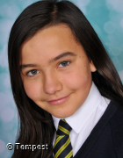
KS2
Tom always attends school with a cheery disposition and works to the best of his ability in all lessons. Tom is a great all-rounder and highly deserves this recognition.
T A
KS3
Headteacher’s awards
Autumn 2020
Tom A – 6A
Sofia applies herself well in all lessons and presents with a quiet, demure maturity that is well beyond her years. Sofia is a real credit to herself and the school.
Sophia P – 7B

