Slide 1
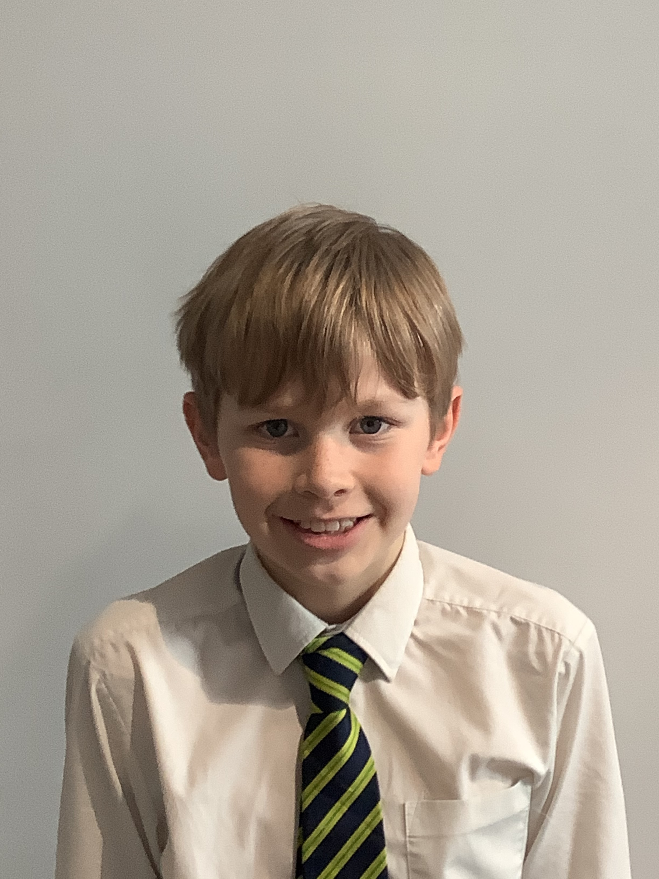
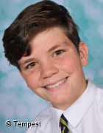
KS2
Charlie - For showing care and concern towards another pupil who needed help.
KS3
Headteacher’s awards
Spring 2 2021
Charlie – Year 5
Joe – For displaying humility and a mature attitude towards others.
Joe – Year 7

