Slide 1
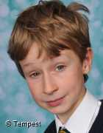
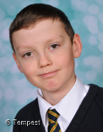
KS2
Peter always shows 100% commitment to his work and tries hard in all that he does.
KS3
Headteacher’s awards
Summer 1 2021
Peter – Year 5
Hayden has a kind nature and has frequently shown compassion and care towards his fellow peers.
Hayden – Year 7

