Slide 1
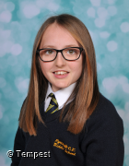
KS2
Poppy’s confidence has grown considerably and she has really come into her own, making fantastic contributions in lessons.
P M
KS3
Headteacher’s awards
Spring 1 2021
Poppy – Year 6
Elisha has engaged fantastically with her online learning in all subject areas, showing 100% commitment and effort.
Elisha – Year 8

