Slide 1
Lockdown Photography
Ryecroft Middle School
Year 8
January 2021

Slide 3
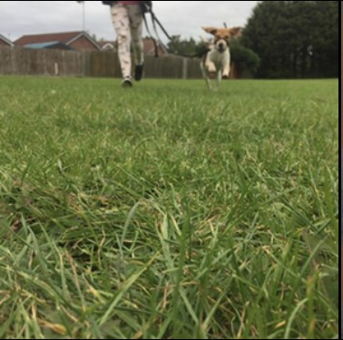

Slide 9
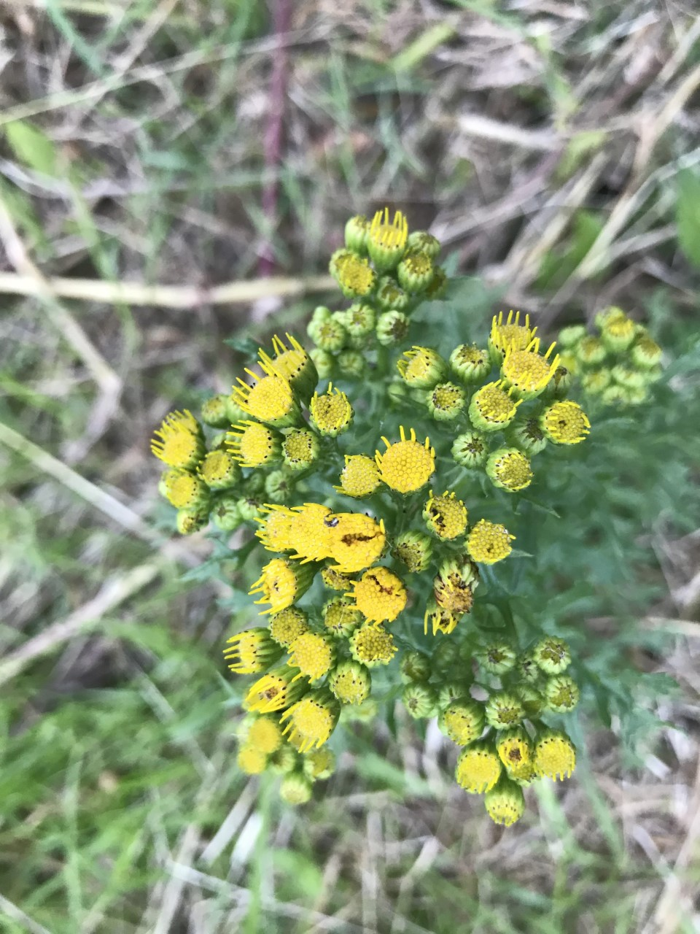

Slide 15
Thanks to the photographers. . . . .
Poppy
Emily
Matthew
Lexi
Madison
Elisha
Calum

Slide 16
If you would like to contribute to the next gallery . . .
Email your work to Miss Alston
dalston@ryecroft.staffs.sch.uk

