Slide 1



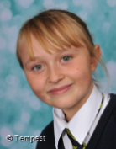
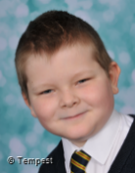
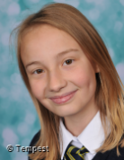
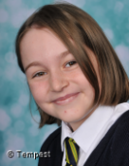
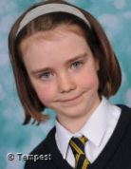
Eliza -5A
Sean – 5A
Kate – 6A
Trust
Perseverance
Humility
For being helpful and trustworthy.
For persevering with the Ryecroft challenges.
For showing humility with the success she’s had across the curriculum.
Ryecroft’s
Star
Awards
Tia – 6A
Tegan – 5B
Scarlett – 5B
KS2
Inspiration
Care
Community
For inspiring others in English and maths
For showing care and consideration as a true friend.
For generous contributions to the food bank.

Slide 2
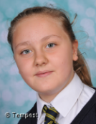
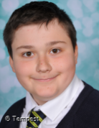
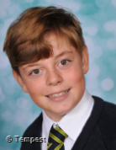
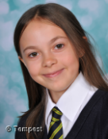
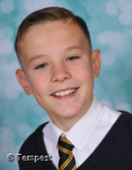
Matilda – 7B
Rhys – 8A
HB
Trust
Perseverance
Humility
For her trust worthy nature and always following the school rules and regulations.
For trying hard in all lessons and persevering in all he does.
For showing humility with the success he’s had across the curriculum.
Ryecroft’s
Star
Awards
Dean – 8B
Sarah – 7B
Aaron – 7A
KS3
Inspiration
Care
Community
For inspiring others in PE lessons.
For having a caring and selfless nature both at hoke and at school.
For generous contributions to the foodbank.

