Slide 1
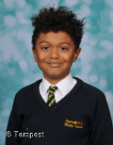
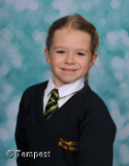
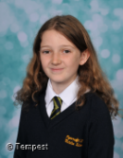
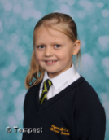
Miles – Year 5
Tilly – Year 5
H A-H
Trust
Perseverance
Humility
For being really helpful at lunchtime and helping to keep outside tidy.
For persevering with riding a bike.
For showing humility with all her success across the curriculum.
Ryecroft’s
Star
Awards
Chloe – Year 6
Daisy – Year 5
F D
KS2
Inspiration
Care
Community
For coming to school with a smile on her face and working incredibly hard.
For showing a caring attitude, both in and out of school.
For helping to litter pick at lunchtime – keeping outside area tidy for the rest of the pupils.

Slide 2
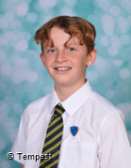
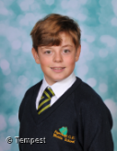
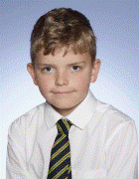
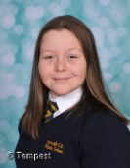
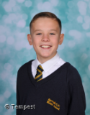
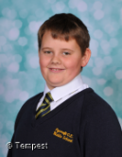
Spencer – Year 8
Dean – Year 8
Cohlten– Year 7
Trust
Perseverance
Humility
For always being trusted to be online – turning up, logging on, tuning in and engaging.
For persevering with his online lessons – even with an injured leg.
For helping others in PE.
Ryecroft’s
Star
Awards
Lily – Year 7
Aaron – Year 7
Tom – Year 7
KS3
Inspiration
Care
Community
For coming to school with a smile of her face and working incredibly hard.
For helping other students with their online learning.
For showing a super attitude towards others in class – particularly in PE.

