Slide 1
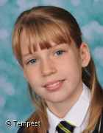
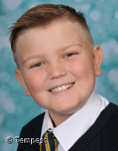
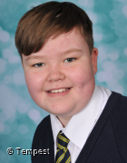
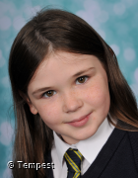
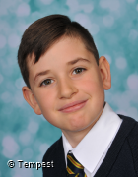
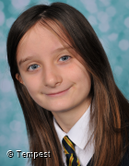
Isabelle – Year 5
Jack– Year 5
Charlie – Year 6
Trust
Perseverance
Humility
Following the Covid-19 regulations very
Seriously.
Perseverance with school work – wanting to do well and get better.
Showing humility and doing a fantastic job in all areas of the curriculum.
Ryecroft’s
Star
Awards
Spring (2)
Jazmine – Year 5
Flynn – Year 5
Felicity – Year 6
KS2
Inspiration
Care
Community
Impeccable behaviour at all times - polite
For excellent contributions to our Easter celebrations.
Charity fundraising

Slide 2
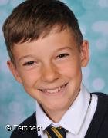
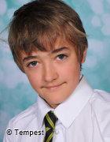
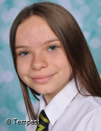
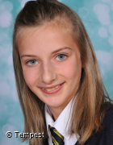
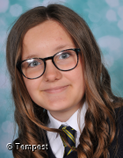
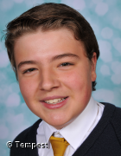
Will – Year 7
Eric – Year 8
Daisy – Year 7
Trust
Perseverance
Humility
For being trusted to follow Covid-19
guidelines
Attending school towards the end of the most recent period of lockdown and showing an improved and more mature attitude towards school.
Unassumingly humble about all her achievements throughout the curriculum.
Ryecroft’s
Star
Awards
Spring (2)
Emily – Year 8
Poppy – Year 7
Patrick – Year 8
KS3
Inspiration
Care
Community
For always listening and helping others.
Continuing to work with our local church to make sure members of our community are supported during this time.
For inspiring others in Y8 to do well and achieve their best.

