Slide 1
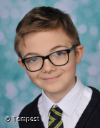
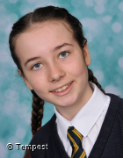
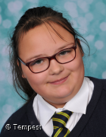
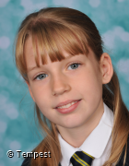
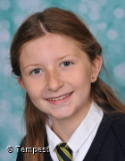
Damien – Year 5
Hollie-Mai – Year 6
Angel – Year 6
Perseverance
Humility
Inspiration
For persevering in practicing riding his bike.
For working hard, achieving targets with minimal fuss and for quietly being a successful pupil across the curriculum.
Is inspiring due to the personal circumstances that she has overcome and for doing great in assessments for English and Maths.
Ryecroft’s
Star
Awards
Summer (1)
Isabel – Year 5
Freya – Year 6
Charley – Year 6
C A-H
KS2
Trust
Care
Community
For being a trusted member of the school community.
For caring for her grandparents during the pandemic
For having her hair cut for charity.

Slide 2
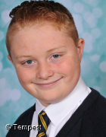
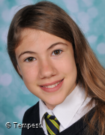
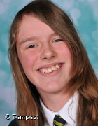
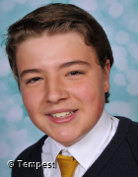
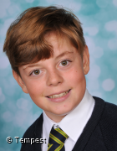
Rhys – Year 7
Emily– Year 7
Eloise – Year 7
E B
Perseverance
Humility
Inspiration
For preserving with improving his behaviour.
For working hard, achieving targets with minimal fuss and for quietly being a successful pupil across the curriculum.
On completing a course on how to be a lawyer.
Ryecroft’s
Star
Awards
Summer (1)
Gracie-May – Year 8
Pat – Year 8
Dean – Year 8
KS3
Trust
Care
Community
For being part of the community group for tidying up Rocester.
For handing in lost property found in Rocester.
Can be trusted to follow the rules and work super hard.

