Slide 1

Ryecroft Middle School
Lockdown Art Gallery

Slide 2
Positive though the Pandemic
A collection of works produced during the lockdown by past and present pupils of Ryecroft Middle School.
“The world always seems brighter when you’ve just made something that wasn’t there before.” – Neil Gaiman

Slide 3
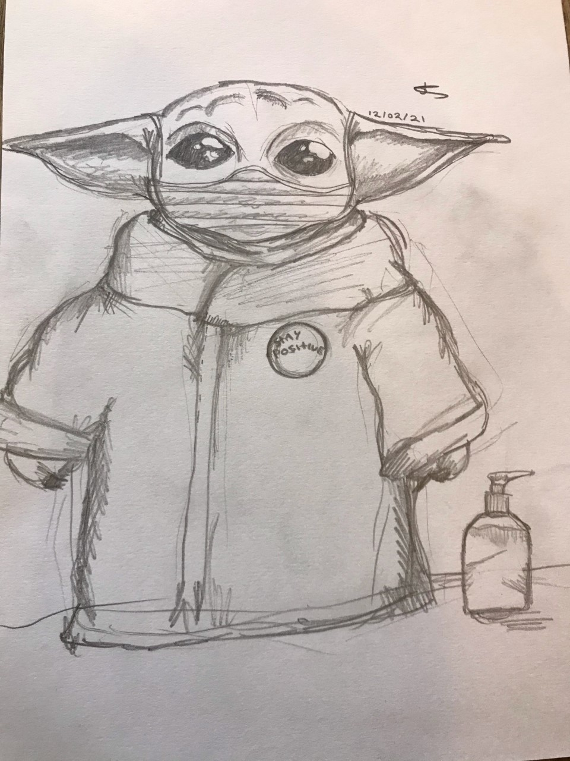
Spencer

Slide 4
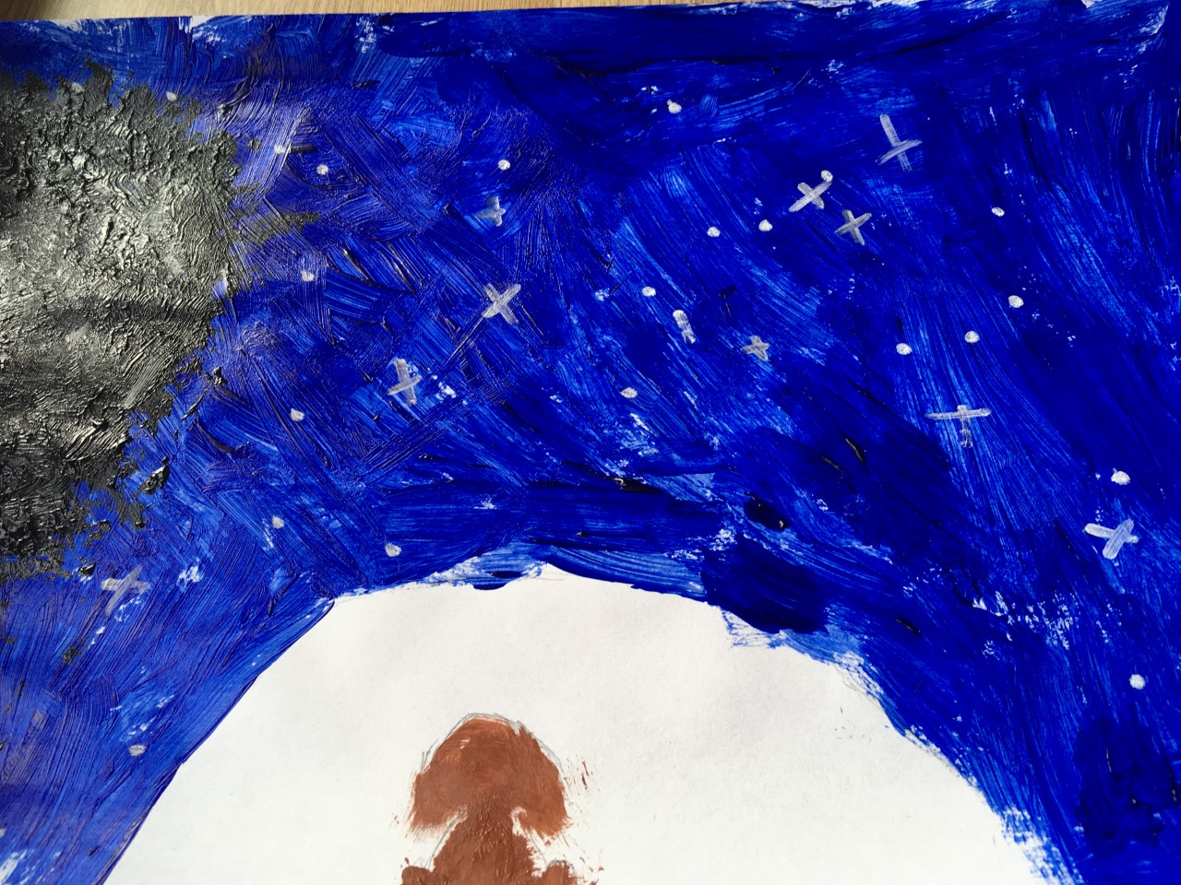
Matilda

Slide 5
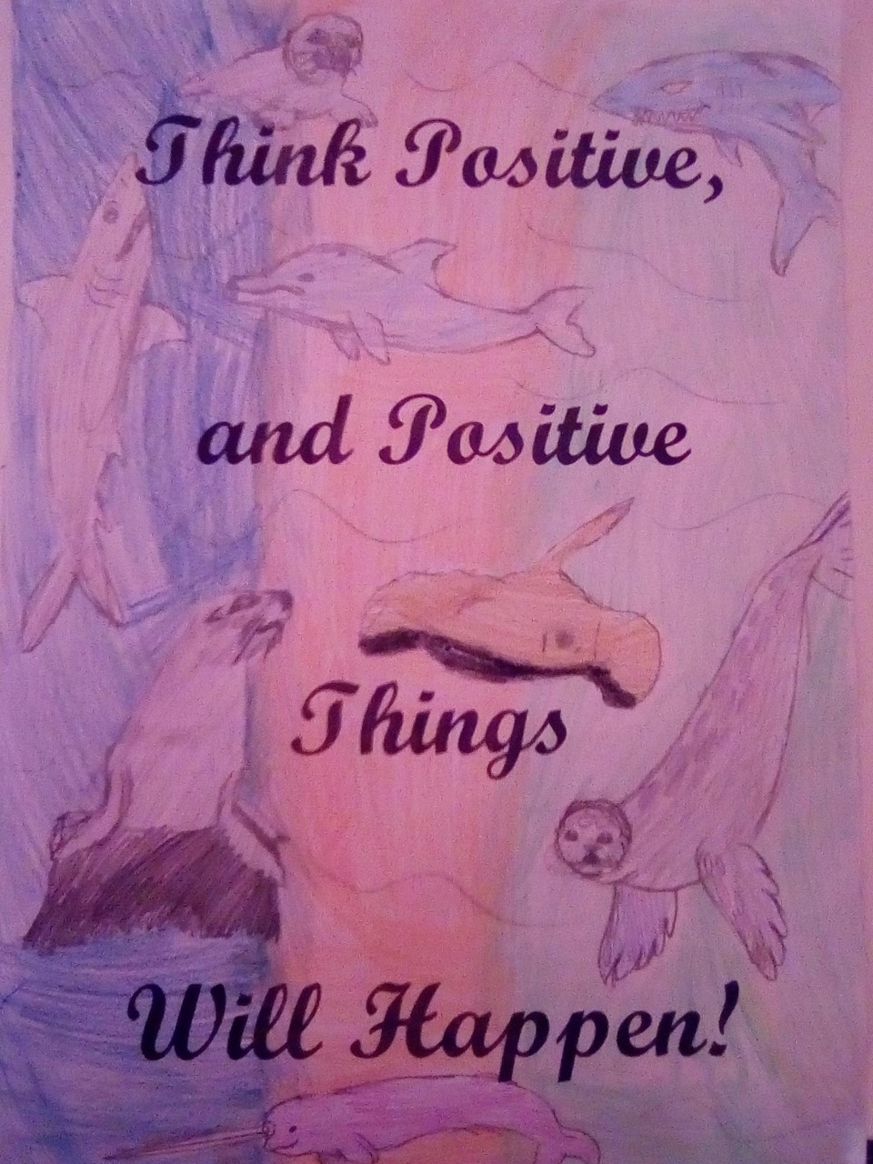
Emily

Slide 6
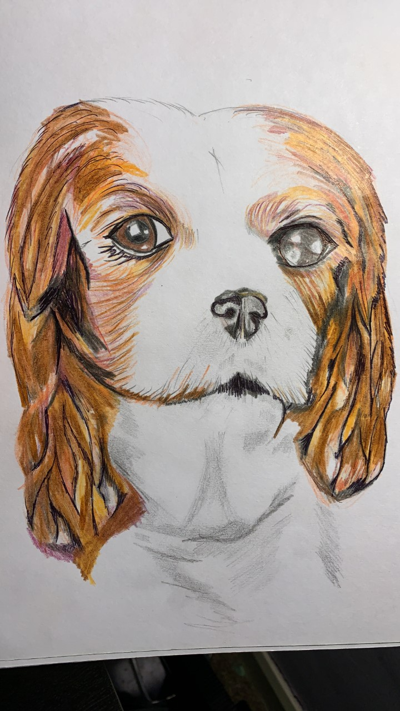
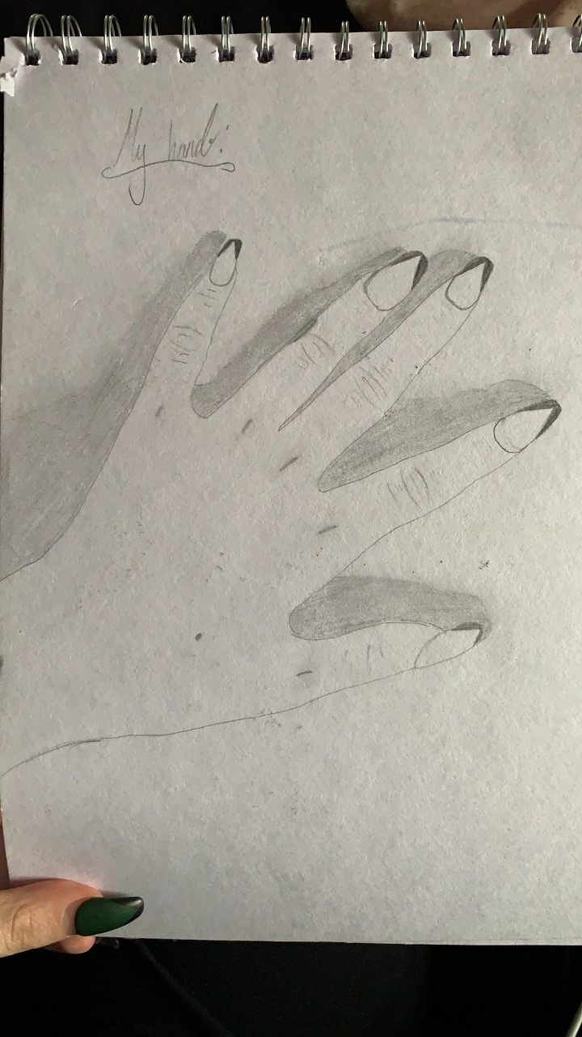
Madison

Slide 7
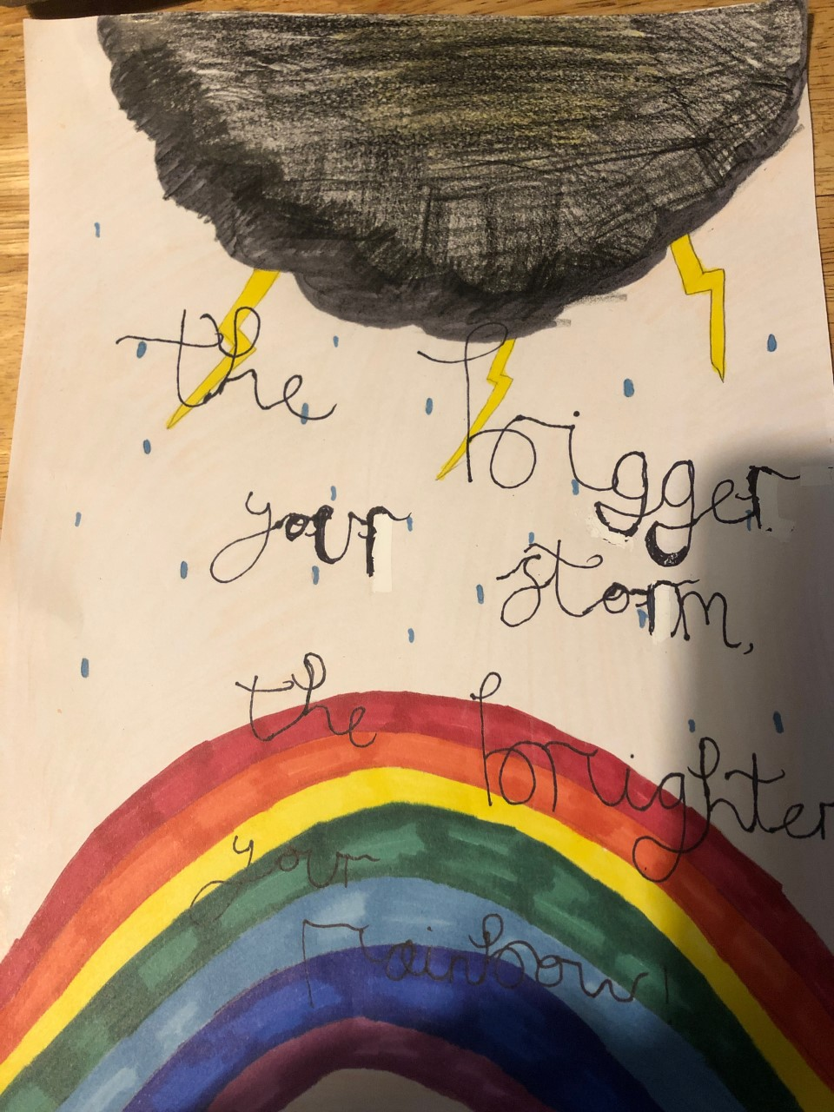
Leah

Slide 8
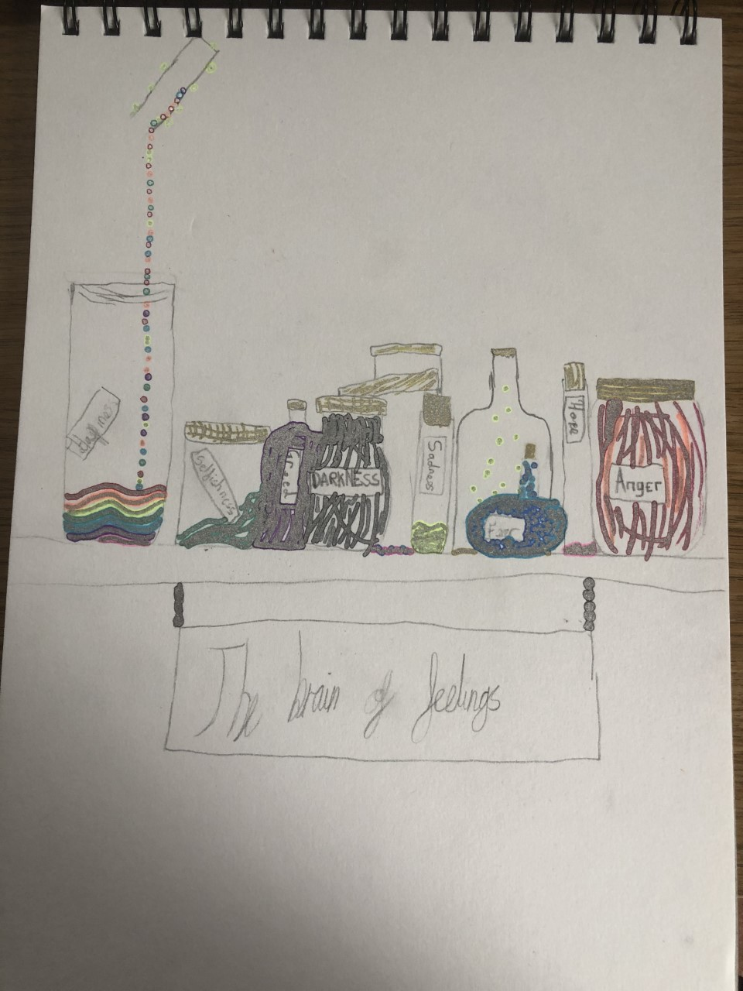
Lily

Slide 9
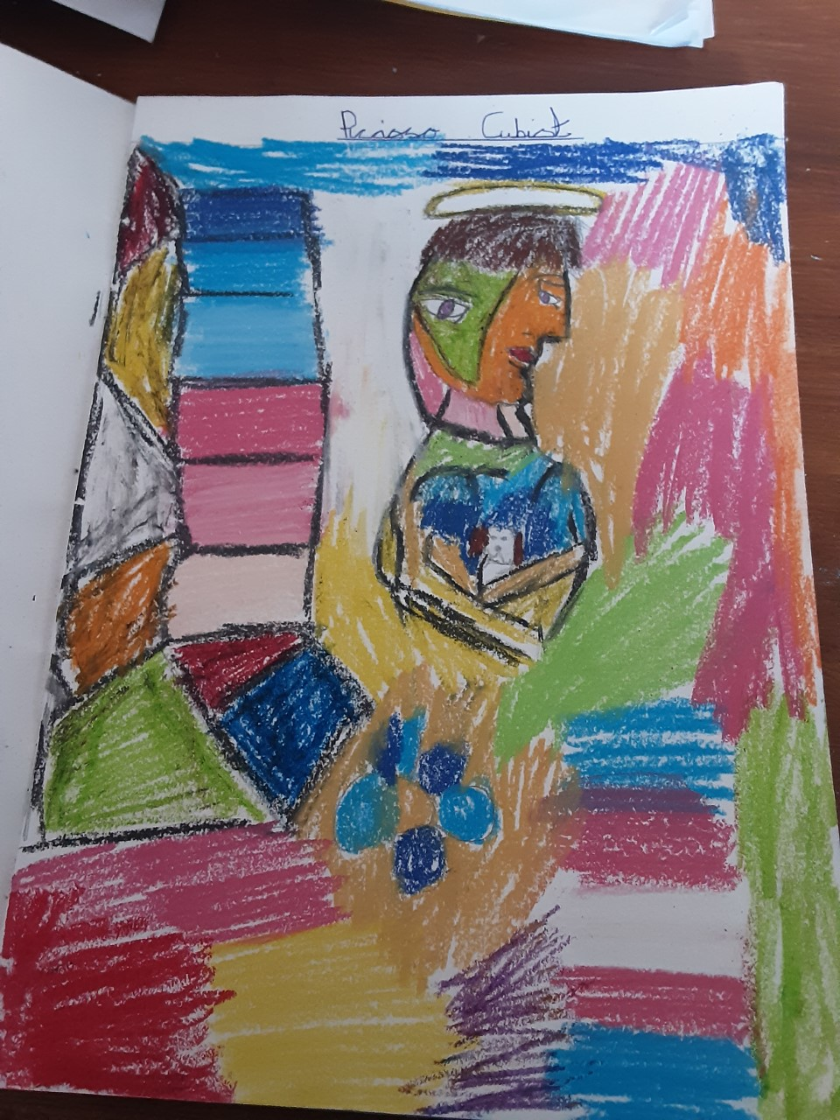
Patrick

Slide 10
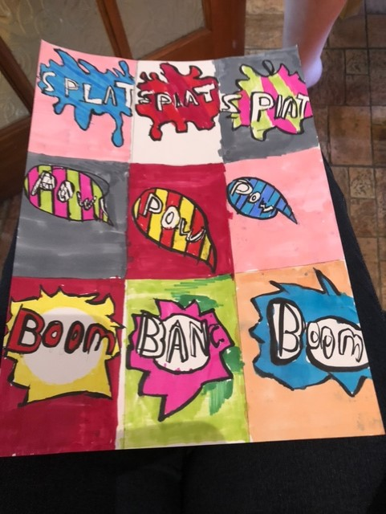
Charlie

Slide 11
Lorelai

Slide 12
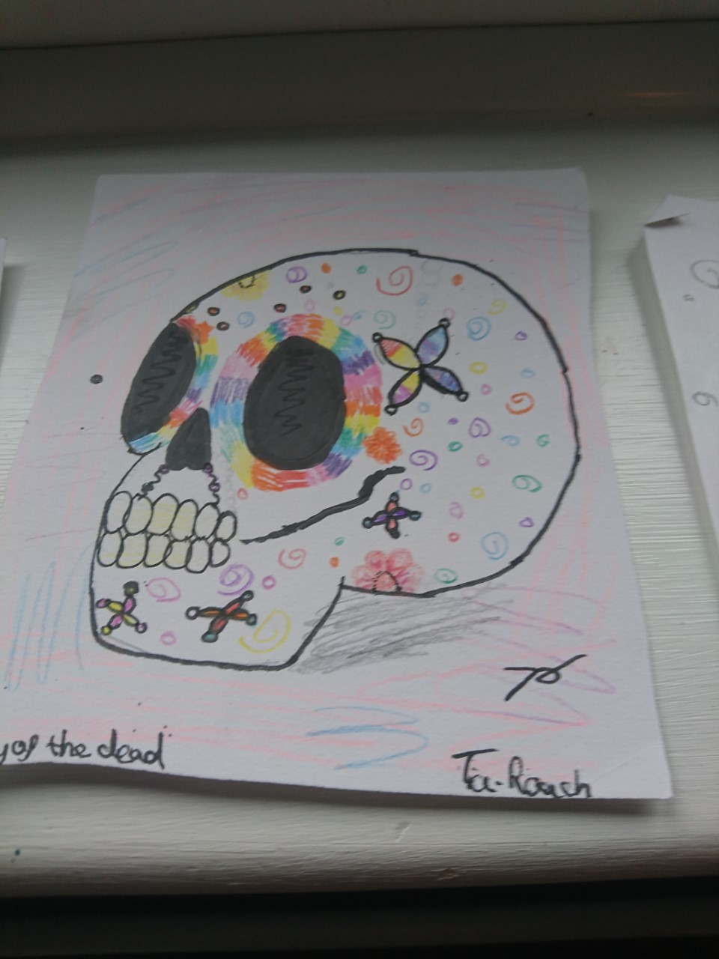
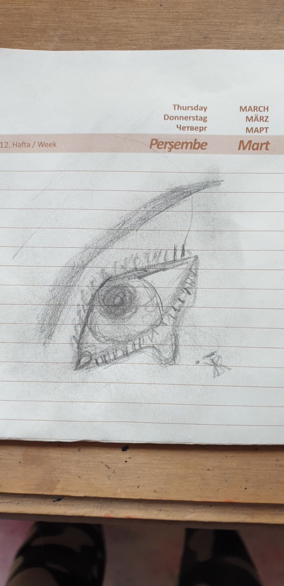
Tia

Slide 13
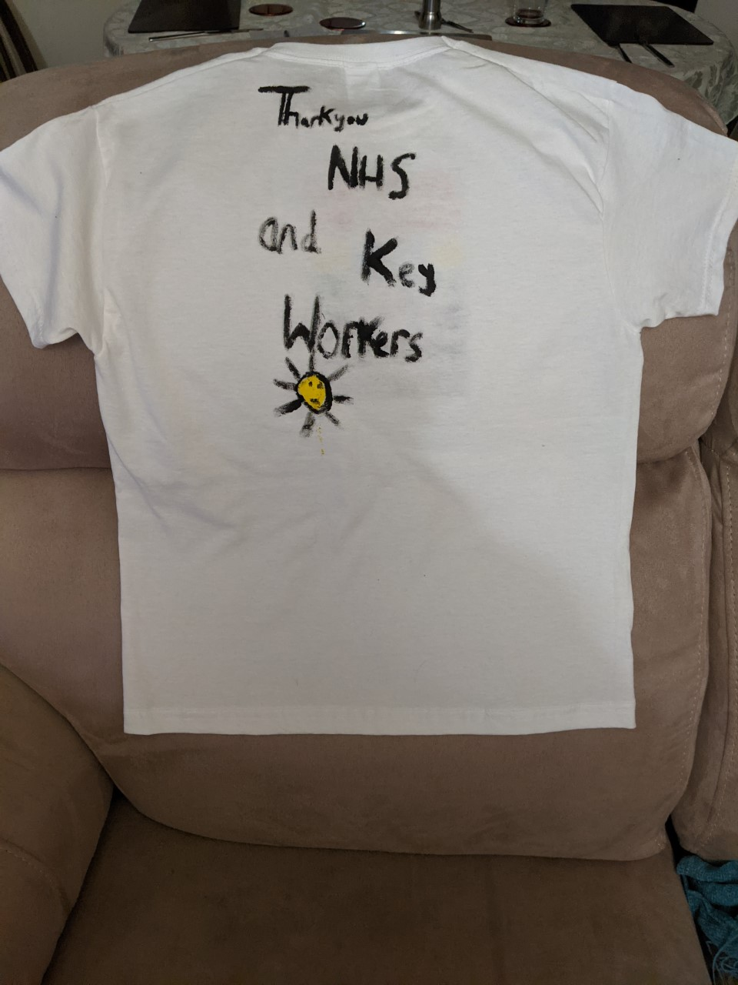
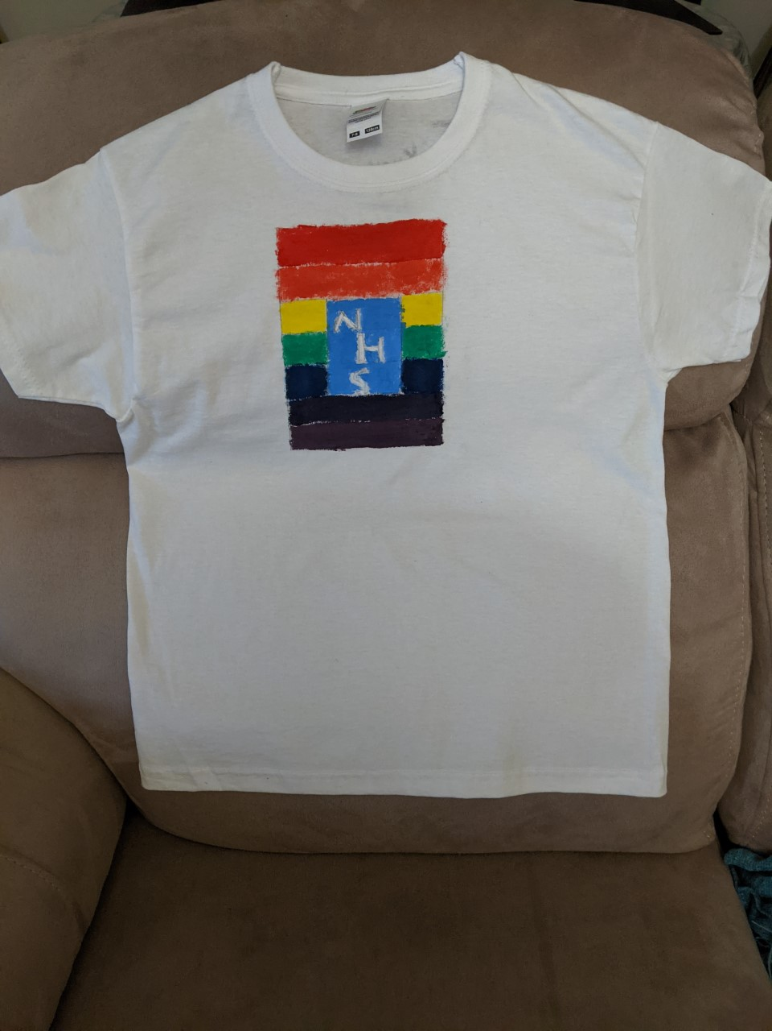
Aimee

